Slide 1
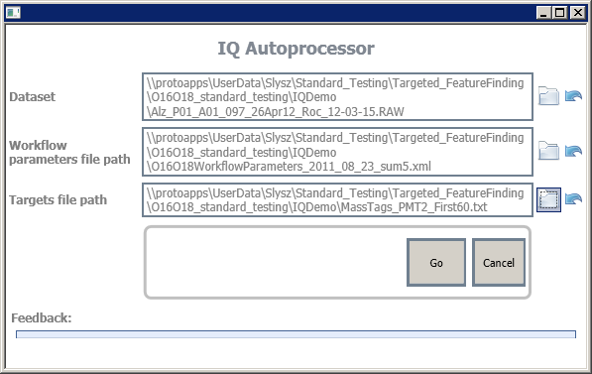
Two ways to run IQ on your data:
Using the ‘IQ Autoprocessor’ program. This is a simple graphical user interface for running IQ. It doesn’t have all the options that the Console version has.
Using the IQConsole.exe or IQConsoleManager.exe. These are console-based programs for running IQ. These are not quite as ‘friendly’ as the ‘IQ Autoprocessor’ but you can do more with them, such as
Batch processing
Specifying locations of results and log files.
Control over LC-alignment of the datasets
IQ Autoprocesor
IQConsole.exe
IQConsole "D:\Data\Orbitrap\QC_Shew_08_04-pt1-3_15Apr09_Sphinx_09-02-16.RAW " "D:\Data\Orbitrap\IQExecutorParameters.xml"

Slide 2
IQ Autoprocessor - Inputs
Select dataset (click the folder or enter the path manually)
Select workflow parameter file. This is an IQ .xml parameter file
Select the targets .txt file. IQ will load these targets and iterate over them.
For PNNL users: see demo files here:
\\protoapps\UserData\Slysz\IQ_Demo

Slide 3
IQ Autoprocessor - Outputs
Two files are outputted:
a _results.txt file containing the results from IQ processing. [TODO: add new slides explaining columns]
a _log.txt file containing some logging information. This file can be opened as the file is being processed.
Output location: currently same folder as RAW file
[TODO: add option for output folder]

Slide 4
IQConsole.exe
Description:
IQConsole processes a single dataset at a time.
How to use IQConsole.exe:
IQConsole.exe minimally requires two command line arguments:
Arg1 = dataset file path (e.g "D:\Data\Orbitrap\QC_Shew_08_04-pt1-3_15Apr09_Sphinx_09-02-16.RAW“)
Arg 2 = file path for IQ executor parameters (e.g. "D:\Data\Orbitrap\IQExecutorParameters.xml")
See below for IQ executor parameters information
Sample command line (assumes that you are in the same folder as the IQConsole.exe program:
IQConsole "D:\Data\Orbitrap\QC_Shew_08_04-pt1-3_15Apr09_Sphinx_09-02-16.RAW " "D:\Data\Orbitrap\IQExecutorParameters.xml"
** note the space characters between each argument.

Slide 5
IQConsoleManager.exe
Description:
The only difference between IQConsoleManager and IQConsole is that IQConsoleManager processes a batch of raw data files and IQConsole processes them one at a time. This is silly and these should be merged together! But this is the way it is for now.
How to use IQConsoleManager.exe:
IQConsoleManager.exe minimally requires two command line arguments:
Arg1 = textfile containing list of dataset file paths (e.g "D:\Data\Orbitrap\datasetList.txt")
Arg 2 = file path for IQ executor parameters (e.g. "D:\Data\Orbitrap\IQExecutorParameters.xml")
See below for IQ executor parameters information
Sample command line (assumes that you are in the same folder as the IQConsoleManager.exe program):
IQConsoleManager "D:\Data\Orbitrap\datasetList.txt“ "D:\Data\Orbitrap\IQExecutorParameters.xml"
** note the space characters between each argument.

Slide 6
IQ parameter files
Description:
There are two parameter files for IQ processing:
IQ executor parameter file
Paths to files needed for IQ processing.
path to the .txt file that contains the Targets
path to the .xml file that contains algorithm-related parameters for IQ processing (see below)
[Optional] path to the targets .txt file used in LC alignment
[Optional] path to the parameter file that defines LC alignment parameters
[Optional] results folder path
[Optional] logging folder path
IQ algorithm parameter file
Contains values / tolerances related to IQ data processing. [TODO: add slide on what these are]
NOTE: the path to this file is defined within the IQ executor parameter file

